Slide 1
Pipeline Depth E-D Analysis

Slide 2
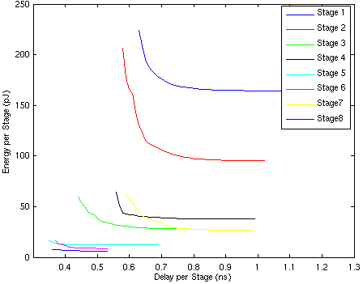
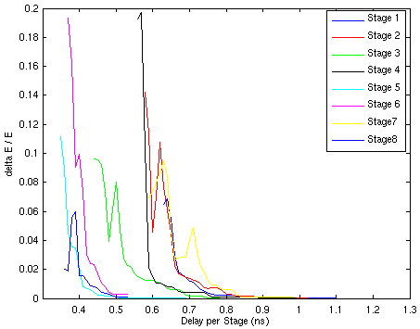
8 Stages - Registers
Booth Encoder
4:2 Tree Stage 1
4:2 Tree Stage 2
4:2 Tree Stage 3
4:2 Tree Stage 4
3:2 Counter
108-Bit Parallel Adder
2:1 Mux
One’s Complement
Leading Zero Detect
Left Shift
Rounding Logic
445 pJ @ 0.65 ns

Slide 3
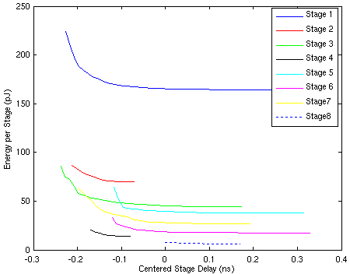
8 Stages - Latches
Booth Encoder
4:2 Tree Stage 1
4:2 Tree Stage 2
4:2 Tree Stage 3
4:2 Tree Stage 4
3:2 Counter
108-Bit Parallel Adder
2:1 Mux
One’s Complement
Leading Zero Detect
Left Shift
Rounding Logic
387 pJ with latches @ 0.65 ns

